Slide 1
EDA - User Analytics in the Telecommunication Industry
10 Academy assignment
DATA EXPLORATORY FINAL REPORT
Niyomukiza Thamar

Slide 2
Motivation/ why doing this
Data exploration is the initial step in data analysis where the user use data visualization and statistical techniques for describing dataset characterizations to better understand the nature of the data.
For this case, I plan to perform the following:
Variable identification: define each variable and its role in the dataset
Univariate analysis: for continuous variables, build box plots or histograms for each variable independently; for categorical variables, build bar charts to show the frequencies
Bi-variable analysis - determine the interaction between variables by building visualization tools
Multi-variable analysis
Detect and treat missing values
Detect and treat outliers
Descriptive: e.g., Mean

Slide 3
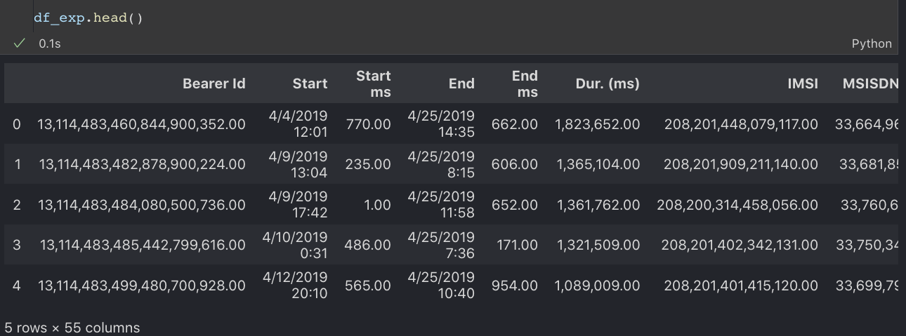
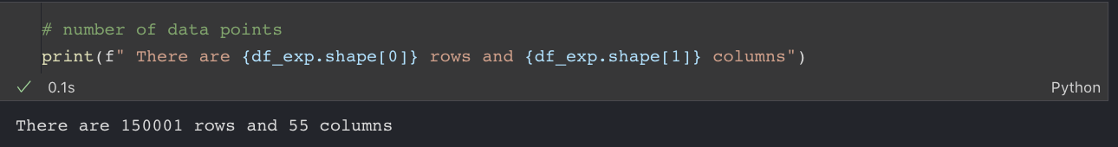
Looking at Data

Slide 4
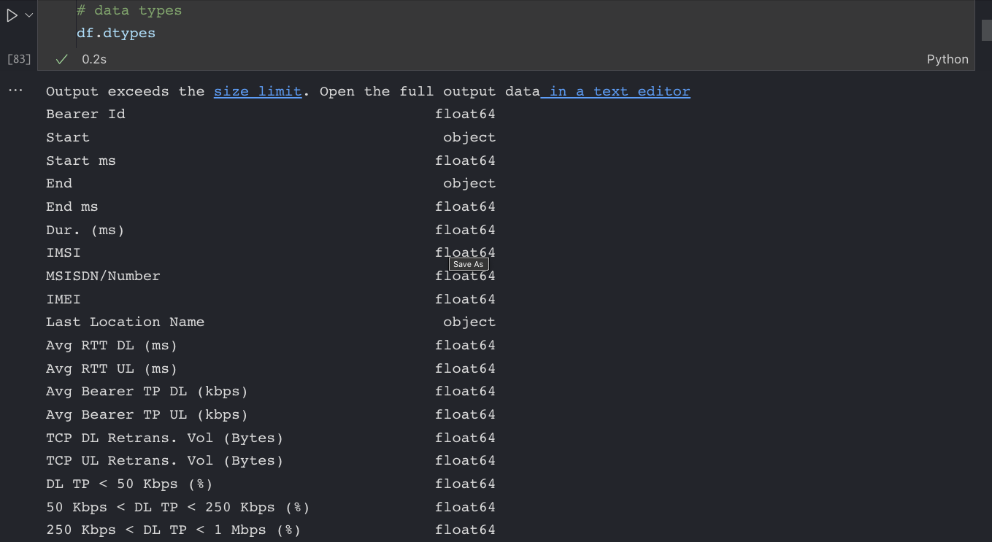
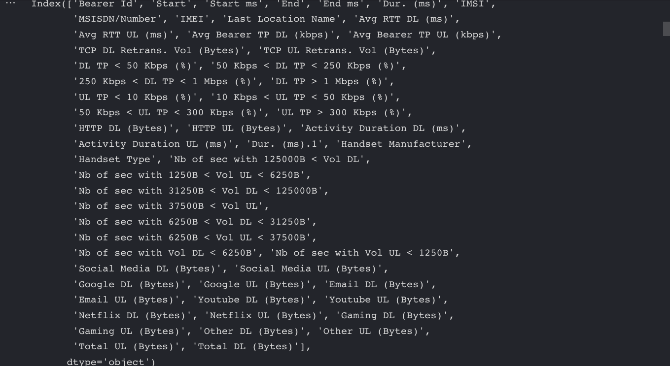
Looking at Data cont’d
The dataset have 55 features describing how the customer has been using our services that we offer.

Slide 5
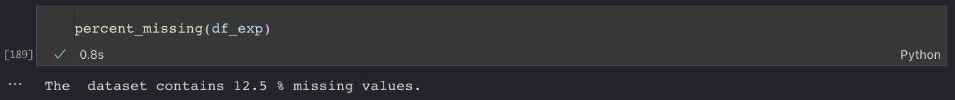
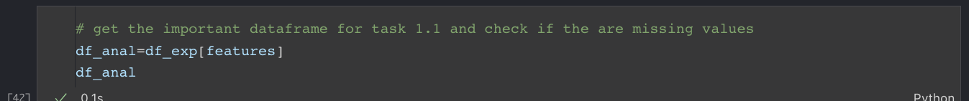
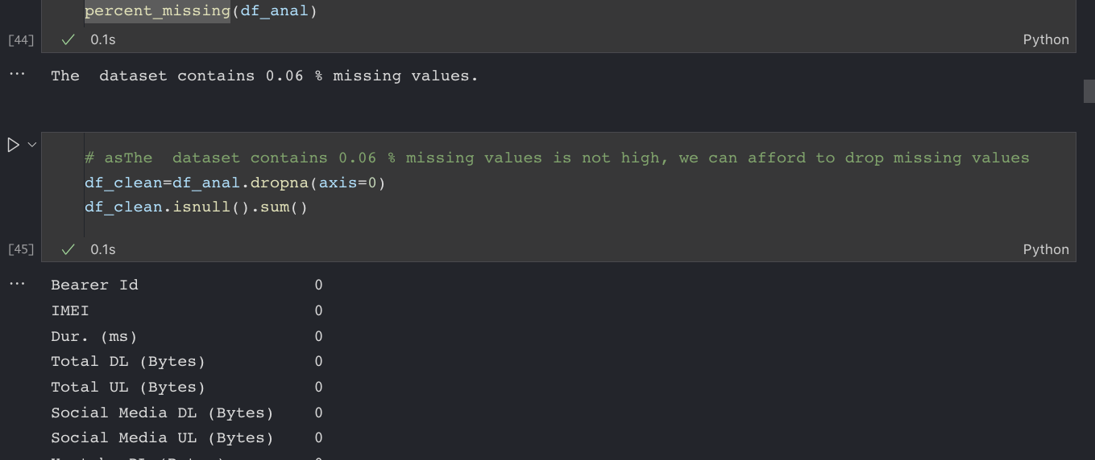
Missing data? What do do about them?

Slide 6
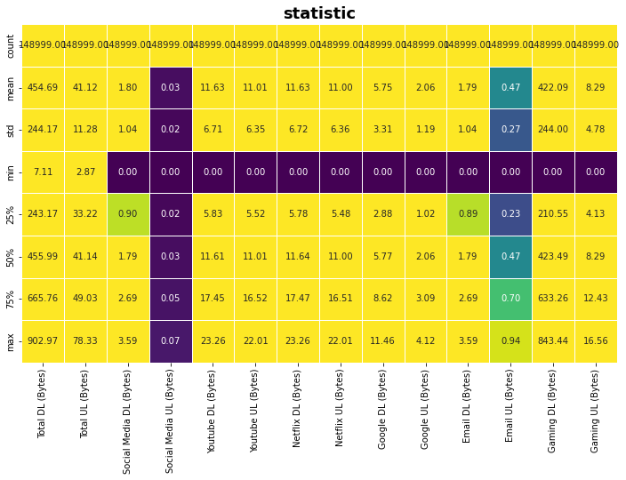
Statistics on the selected features
Looking at the heatmap, the mean of download of games is higher than all other applications used.

Slide 7
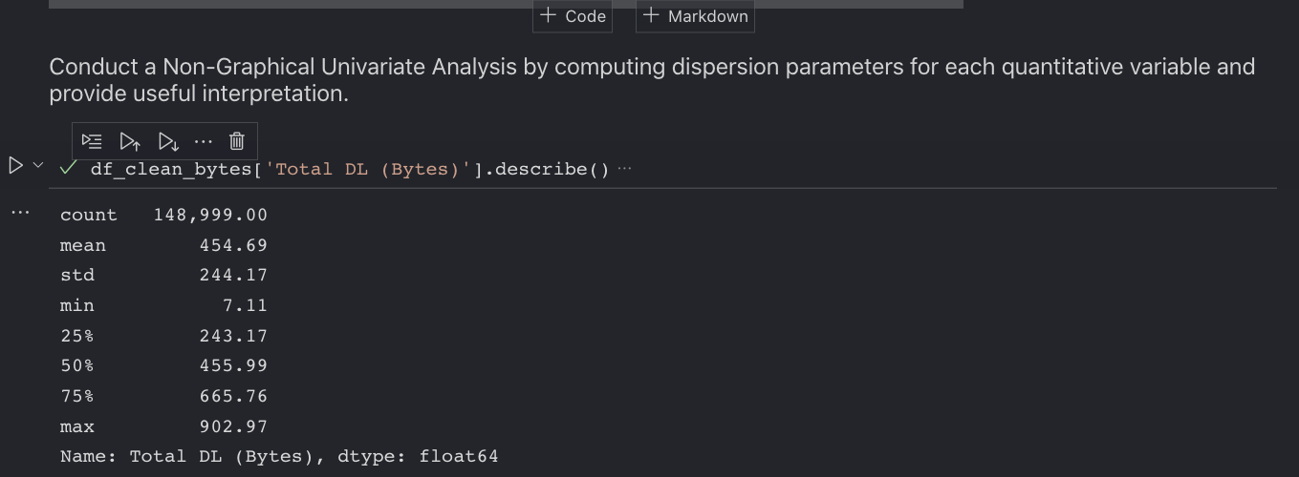
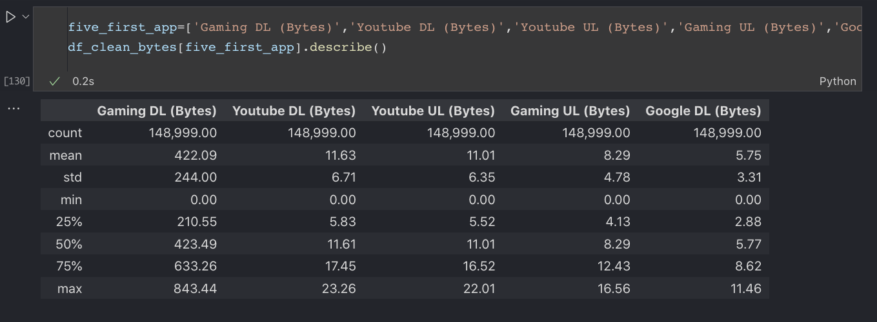
Non-Graphical Univariate Analysis
Again, looking at the statistics
The gaming dounloading activity is the most used by our users

Slide 8
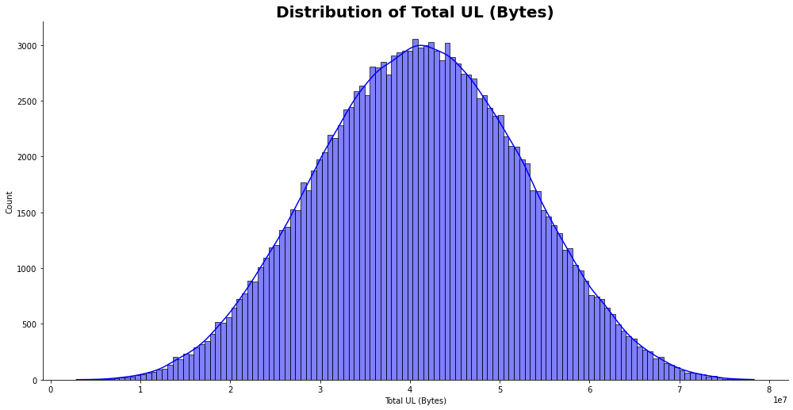
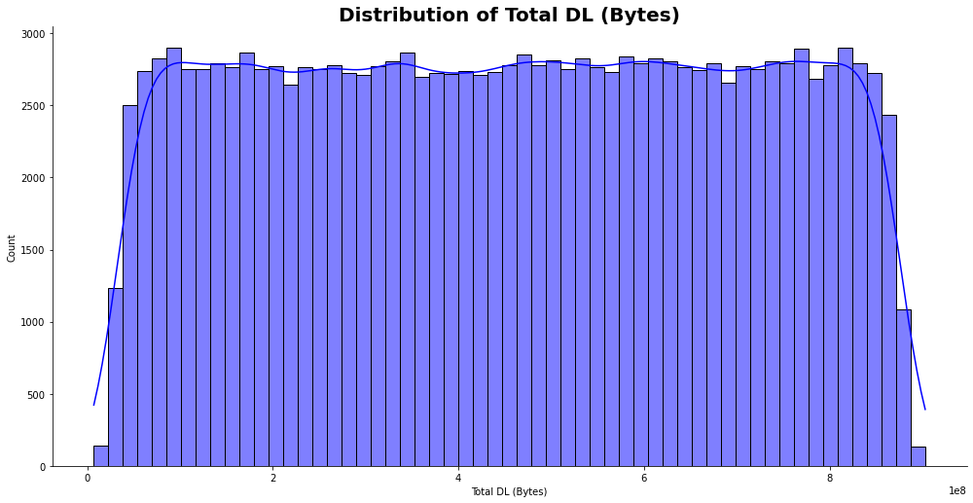
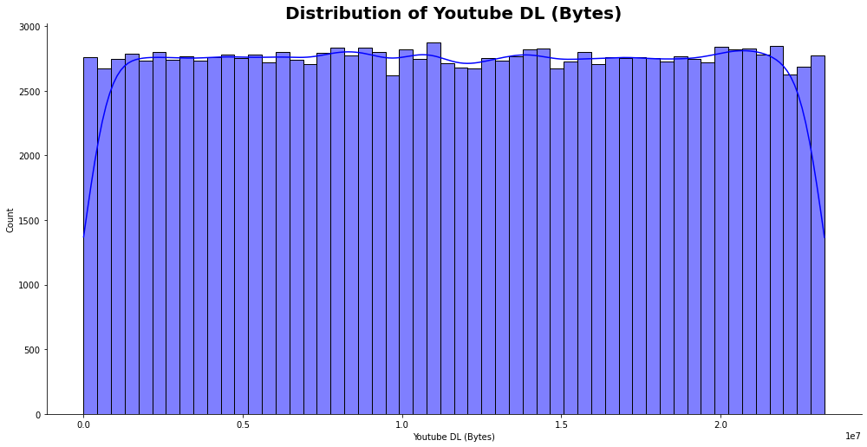
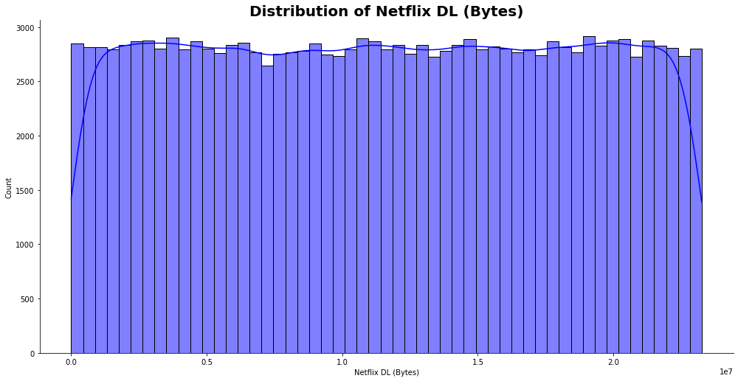
Graphical Univariate Analysis

Slide 9
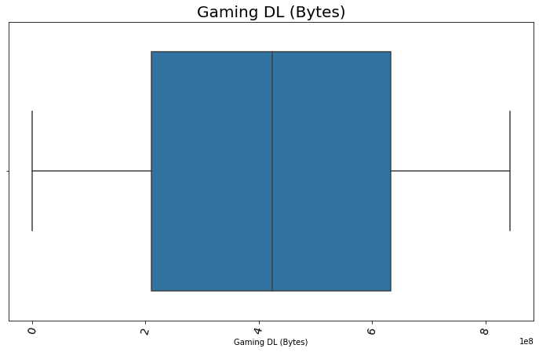
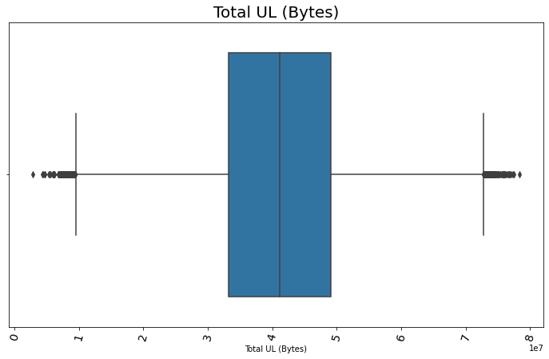
Graphical Univariate Analysis cont’d
Most Gaming download Bytes are between 2 and 6.5 *1e8 while the total uploads have outliers that we must investigate and solve .

Slide 10
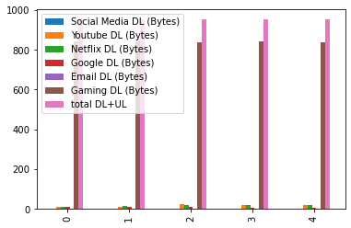
Bivariate Analysis
explore the relationship between each application & the total DL+UL.
The gaming download is what makes the most volume of the the total of the summation of download and uploads

Slide 11
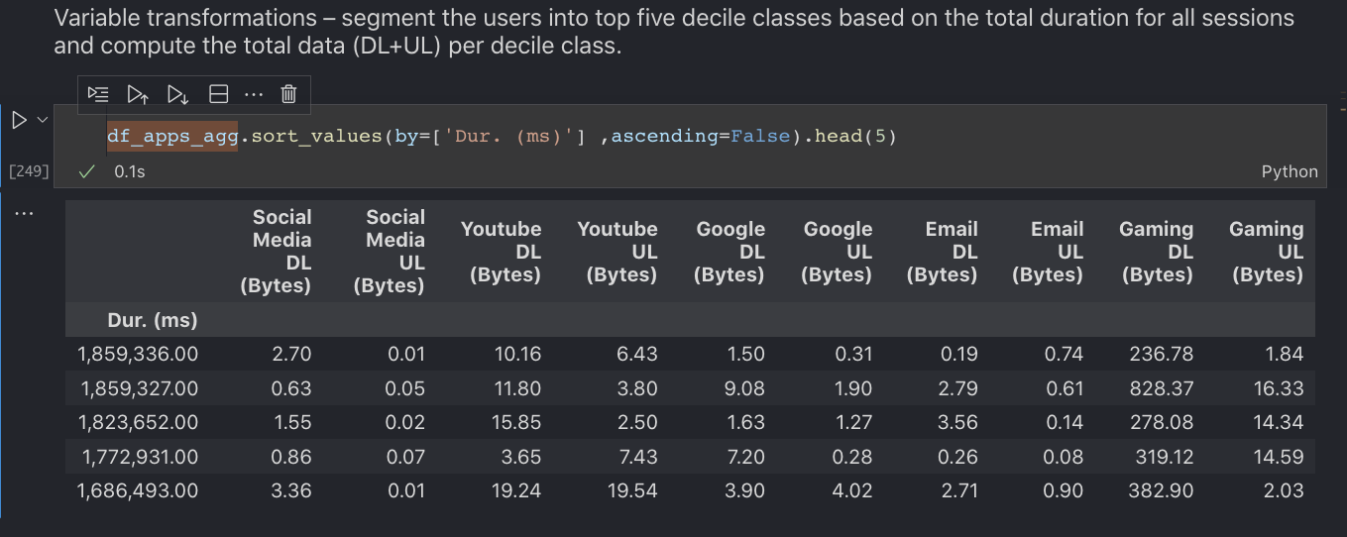
Variable transformations
segment the users into top five decile classes based on the total duration for all sessions.

Slide 12
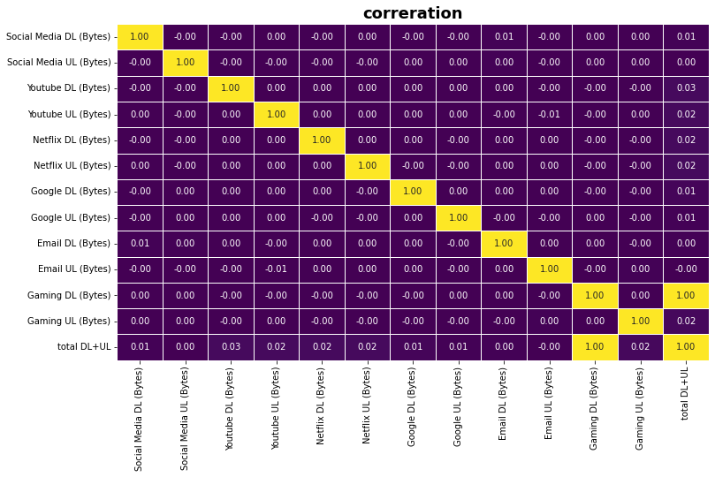
Correlation Analysis
Investigating the matrix, the only correction is between the gaming DL and the total download and upload. Gaming DL can introduce multicollinearity in our model.

Slide 13
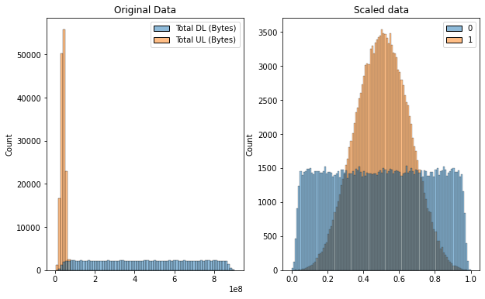
Scaling data

Slide 14
Dimensionality Reduction
perform a principal component analysis to reduce the dimensions of your data and provide a useful interpretation of the results (Provide your interpretation in four (4) bullet points-maximum).

Slide 15
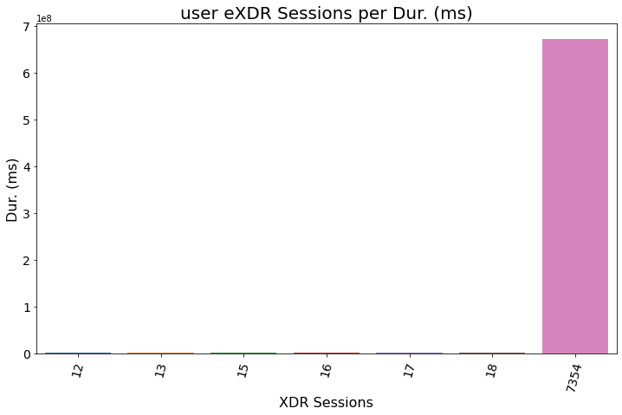
Task 2 - User Engagement analysis

Slide 16
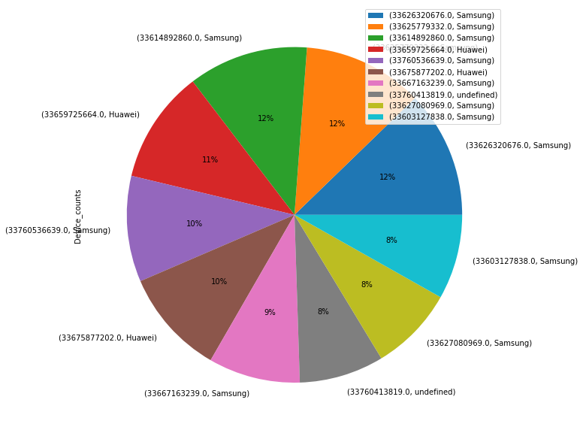
User Engagement analysis

Slide 17
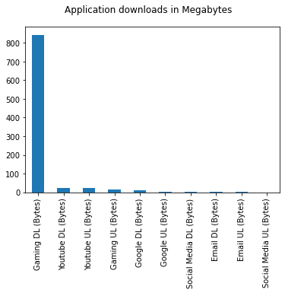

Slide 19
Task 3 - Experience Analytics

Slide 20
Task 4 - Satisfaction Analysis

Slide 21
Conclusion
We have seen that users are using our services
The engagement analysis has show that gaming is dominating so we nned to put effort in this area.
Note: the tasks are not all accomplished, but the process was reaveling some import insights. I will carry on after finishing this week’s (week 2) challenge.

Slide 22

END

